Slide 1
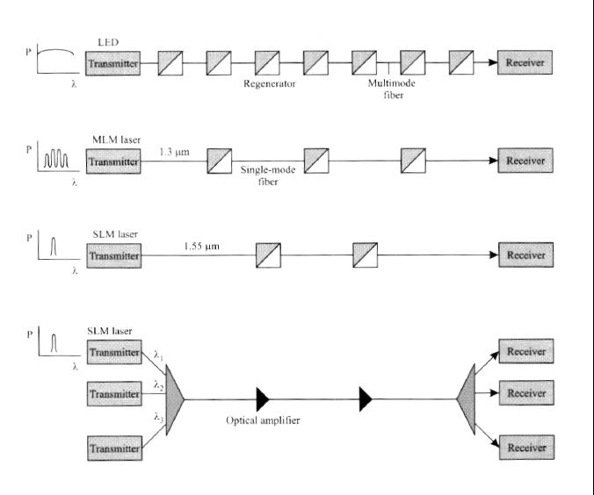
Evolution of the Technology

Slide 2
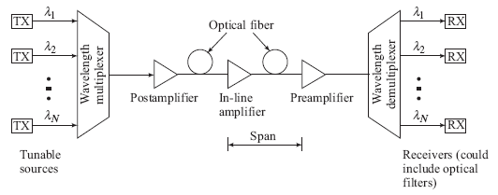
Overview of WDM
A characteristic of WDM is that the discrete wavelengths form an orthogonal set of carriers that can be separated, routed, and switched without interfering with each other.
WDM networks require a variety of passive and active devices to combine, distribute, isolate, and amplify optical power at different wavelengths.

Slide 3
Why WDM?
Capacity upgrade of existing fiber networks (without adding fibers)
Transparency: Each optical channel can carry any transmission format (different asynchronous bit rates, analog or digital)
Scalability– Buy and install equipment for additional demand as needed
Wavelength routing and switching: Wavelength is used as another dimension to time and space

Slide 4
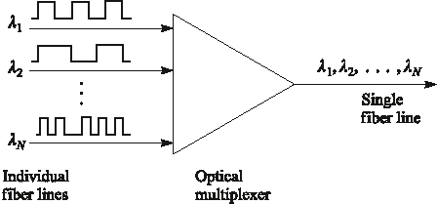
Wavelength Division Multiplexing
Each wavelength is like a channel (fiber)

Slide 5
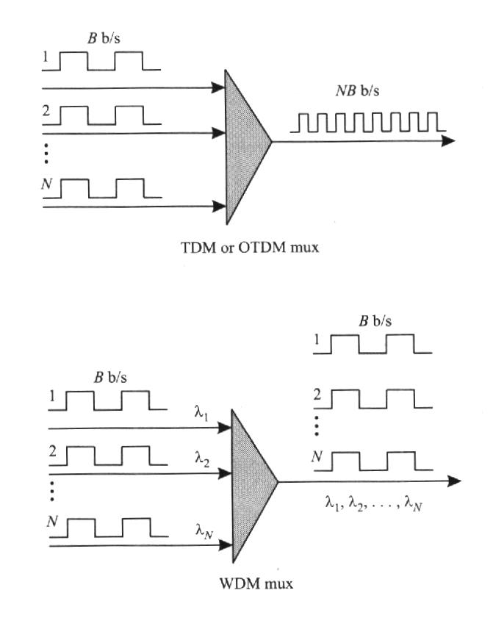
TDM Vs WDM
Ex: SONET

Slide 6
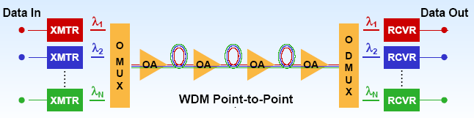
Wavelength Division Multiplexing
Passive/active devices are needed to combine, distribute, isolate and amplify optical power at different wavelengths

Slide 7
WDM, CWDM and DWDM
WDM technology uses multiple wavelengths to transmit information over a single fiber
Coarse WDM (CWDM) has wider channel spacing (20 nm) – low cost
Dense WDM (DWDM) has dense channel spacing (0.8 nm) which allows simultaneous transmission of 16+ wavelengths – high capacity

Slide 8
WDM and DWDM
First WDM networks used just two wavelengths, 1310 nm and 1550 nm
Today's DWDM systems utilize 16, 32,64,128 or more wavelengths in the 1550 nm window
Each of these wavelength provide an independent channel (Ex: each may transmit 10 Gb/s digital or SCMA analog)
The range of standardized channel grids includes 50, 100, 200 and 1000 GHz spacing
Wavelength spacing practically depends on:
laser linewidth
optical filter bandwidth

Slide 9
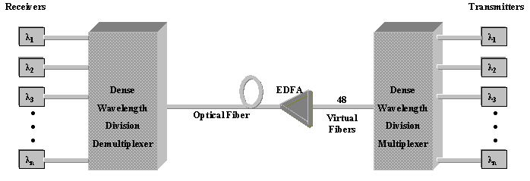
DWDM System
Block Diagram of DWDM System

Slide 10
DWDM Components
Transmitter : Laser with precise stable wavelength.
Link: Optical fiber that exhibits low loss and transmission performance in relevant wavelength spectra.
Receiver: Photo detectors and Optical demultiple-xers using thin film filters or diffractive elements.
Optical add/drop multiplexers and optical cross connect components.

Slide 11
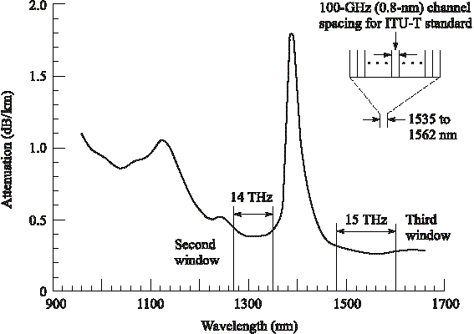
ITU-T Standard Transmission DWDM windows
Many independent narrowband regions in the O- through L-bands can be used simultaneously.
These regions are designated either in terms of spectral width or optical bandwidth.
The optical bandwidth Δν related to a particular spectral width Δλ is found by differentiating c = λν; for Δλ << λ²

Slide 12
Principles of DWDM
BW of a modulated laser: 10-50 MHz → 0.001 nm
Typical Guard band: 0.4 – 1.6 nm
80 nm or 14 THz @1300 nm band
120 nm or 15 THz @ 1550 nm
Discrete wavelengths form individual channels that can be modulated, routed and switched individually
These operations require variety of passive and active devices

Slide 13
Nortel OPTERA 640 System
64 wavelengths each carrying 10 Gb/s

Slide 14
DWDM Limitations
Theoretically large number of channels can be packed in a fiber
For physical realization of DWDM networks we need precise wavelength selective devices
Optical amplifiers are imperative to provide long transmission distances without repeaters

Slide 15
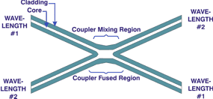
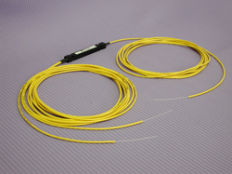
Optical Couplers
Optic couplers either split optical signals into multiple paths or combine multiple signals on one path.
The number of input (N)/ output (M) ports, (i.e. N x M size) characterizes a coupler.
Fused couplers can be made in any configuration, but they commonly use multiples of two (2 x 2, 4 x 4, 8 x 8, etc.).

Slide 16
Optical Couplers
Uses
Splitter: (50:50)
Taps: (90:10) or (95:05)
Combiners
An important issue:
two output differ π/2 in phase
Applications:
Optical Switches,
Mach Zehnder Interferometers,
Optical amplifiers,
passive star couplers, ...

Slide 17
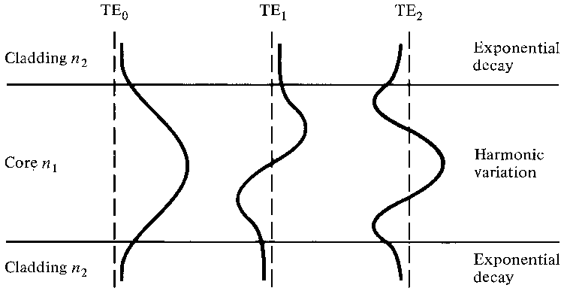
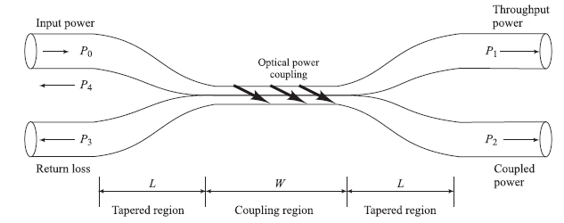
The 2 × 2 Fiber Coupler
P₀ is the input power, P₁ is the throughout power, and P₂ is the power coupled into the second fiber.
P₃ and P₄ are extremely low signal levels (-50 to -70 dB below the input level) resulting from backward reflections and scattering in the device
The evanescent tail from one fiber core couples into another closely spaced fiber core
Optical power
coupling

Slide 18
Performance Parameters
Coupling ratio or splitting ratio
In dB
For 2 x 2 coupler
Excess Loss

Slide 19
Performance Parameters
Insertion Loss
Isolation Loss or Crosstalk
In dB

Slide 20
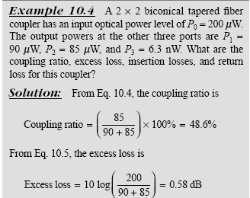
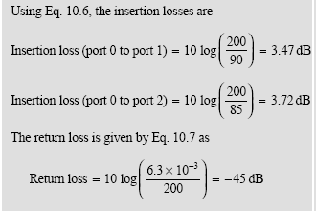
Example Coupler Performance

Slide 21
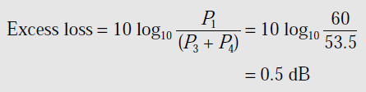
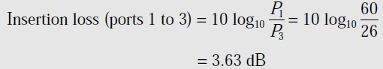
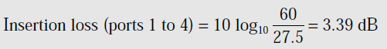
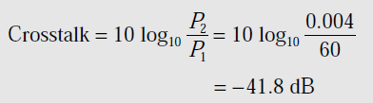
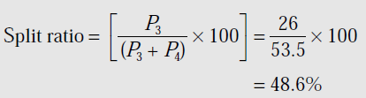
A four-port multimode fiber FBT coupler has 60 μW optical power launched into port 1. The measured output powers at ports 2, 3 and 4 are 0.004, 26.0 and 27.5 μW respectively. Determine the excess loss, the insertion losses between the input and output ports, the crosstalk and the split ratio for the device.
Solution:
The excess loss for the coupler
The Insertion Loss
Cross Talk
Split Ratio

Slide 22
Star Couplers
Optical couplers with more than four ports.
Types of star couplers:
transmission star coupler
the light at any of the input port is split equally through all output ports.
reflection star coupler

Slide 23
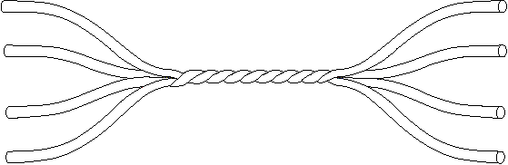
Fibre Star Coupler
Combines power from N inputs and divided them between M outputs
1
P₁
1
P_{N}
N
N
Coupling ratio
Excess loss
Power at any one output

Slide 24
Star Coupler - 8 X 8
Star couplers are optical couplers with more than four ports
λ₁
λ₁, λ₂, ... λ₈
λ₂
λ₃
λ₄
N/2
λ₅
λ₆
λ₇
λ₈
λ₁, λ₂, ... λ₈
No of 3 dB coupler

Slide 25
Star Coupler - 8 X 8 - contd.
If a fraction of power traversing each 3 dB coupler = F_{p},
where 0< F_{p} < 1.
Then, power lost within the coupler = 1- F_{p}.
Excess loss
Coupling ratio
(splitting loss)
Total loss = splitting loss + excess loss

Slide 26
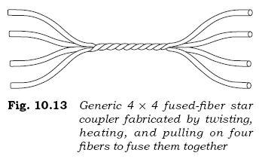
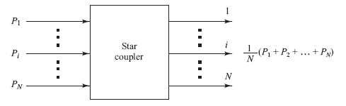
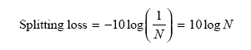
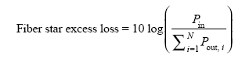
Star Couplers
In general, an N × M coupler has N inputs and M outputs

Slide 27
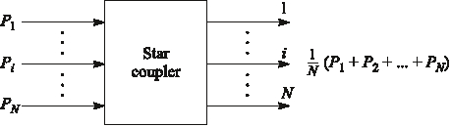
Basic Star Coupler
May have N inputs and M outputs
Can be wavelength selective/nonselective
Up to N =M = 64, typically N, M < 10

Slide 28
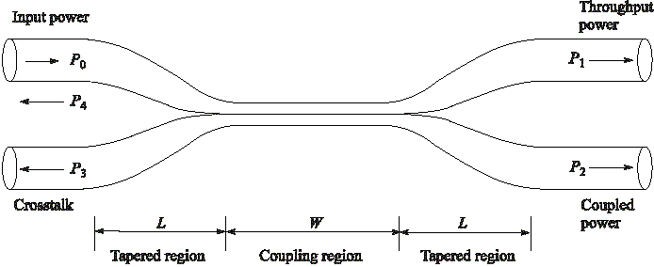
Fused-Biconical coupler OR Directional coupler
P3, P4 extremely low ( -70 dB below Po)
Coupling / Splitting Ratio = P2/(P1+P2)
If P₁=P₂ → It is called 3-dB coupler

Slide 29
Fused Biconical Tapered Coupler
Fabricated by twisting together, melting and pulling together two single mode fibers
They get fused together over length W; tapered section of length L; total draw length = L+W
Significant decrease in V-number in the coupling region; energy in the core leak out and gradually couples into the second fibre

Slide 30
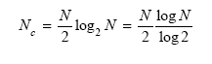
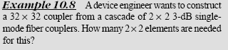
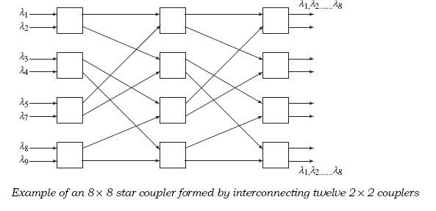
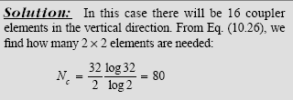
N × N Star Coupler
Can construct star couplers by cascading 3-dB couplers
The number of 3-dB couplers needed to construct an N × N star is

Slide 31
Coupler Characteristics
power ratio between both output can be changed by adjusting the draw length of a simple fused fiber coupler
It can be made a WDM de-multiplexer:
Example, 1300 nm will appear output 2 (p2) and 1550 nm will appear at output 1 (P1)
However, suitable only for few wavelengths that are far apart, not good for DWDM

Slide 32
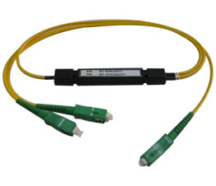
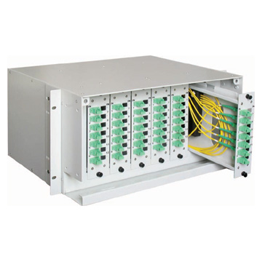
1x2 coupler
6x6 coupler

Slide 33
Splitters
The simplest couplers are fiber optic splitters.
They possess at least three ports but may have more than 32 for more complex devices.
Popular splitting ratios include 50%-50%, 90%-10%, 95%-5% and 99%-1%; however, almost any custom value can be achieved.
Excess loss: assures that the total output is never as high as the input. It hinders the performance. All couplers and splitters share this parameter.
They are symmetrical. For instance, if the same coupler injected 50 µW into the 10% output leg, only 5 µW would reach the common port.
Output
Output
Input

Slide 34
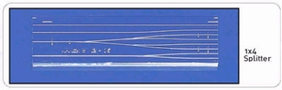
Coupler + Splitter - Applications
Local monitoring of a light source output (usually for control purposes).
Distributing a common signal to several locations simultaneously.
Making a linear, tapped fiber optic bus. Here, each splitter would be a 95%-5% device that allows a small portion of the energy to be tapped while the bulk of the energy continues down the main trunk.

Slide 35
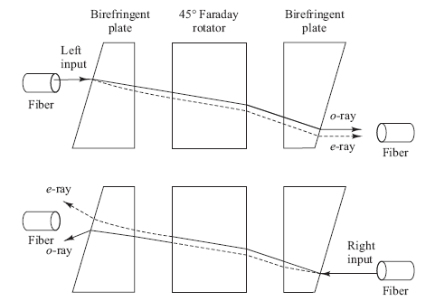
Optical Isolators
Optical isolators allow light to pass in only one direction.
This prevents scattered or reflected light from traveling in the reverse direction.
E.g., can keep backward-traveling light from entering a laser diode and possibly causing instabilities in the optical output.
Polarization-independent isolator made of three miniature optical components

Slide 36
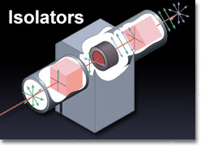
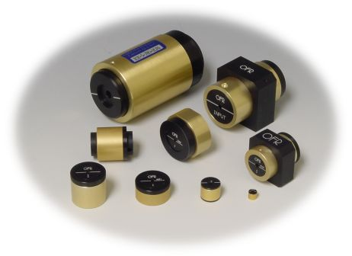
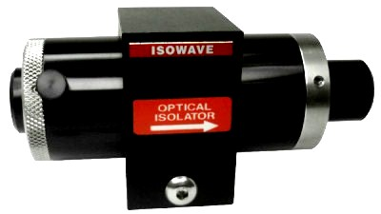
Isolators
5cm

Slide 37
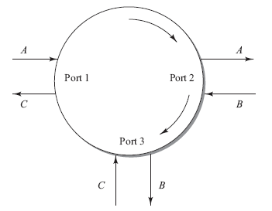
Optical Circulators
An optical circulator is a nonreciprocal multiport passive device that directs light sequentially from port to port in only one direction.
In the 3–port example, an input on port 1 is sent out on port 2, an input on port 2 is sent out on port 3, and an input on port 3 is sent out on port 1.

Slide 38
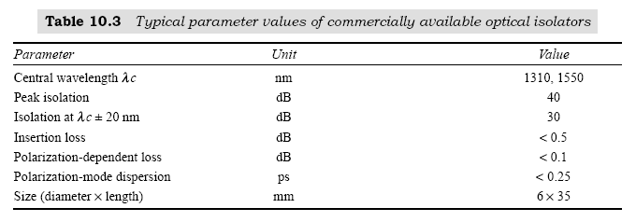
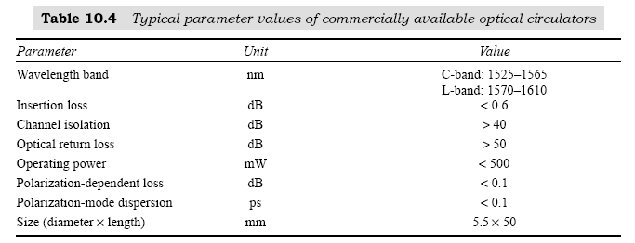
Isolator and Circulator Parameters

Slide 39
Mach-Zehnder Interferometer Multiplexers
Wavelength-dependent multiplexer/demultiplexer (WDM) can be made using Mach-Zehnder (MZ) interferometers.
2x2 MZ interferometer consists of 3 stages: 3-dB splitter, phase shift, 3-dB combiner.
Due to the phase shift between the two arms, the recombined signals will interference constructively at one output and destructively at the other :
Demultiplexer (Demux) : Ein,1 will separate at Eout,1, Eout,2
Multiplexer (Mux) : Both outputs Eout,1 and Eout,2 combine at Ein,1

Slide 40
Layout of a basic 2 x 2 Mach-Zehnder Interferometer

Slide 41
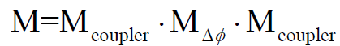
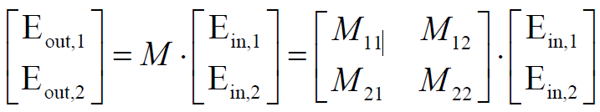
How to find output P1 and P2 by using matrix method ?
Write matrix for each stage:
- phase shift : MΔΦ- Wavelength dependent phase shift
- 3-dB splitting coupler : Mcoupler – Splits the input signal
- 3-dB combining coupler : Mcoupler - Recombines the signal at the output
Obtain the total matrix for MZ interferometer
Find output E-field Eout,1 and Eout,2 :
Find output power (or intensity) Pout,1 and Pout,2 :

Slide 42
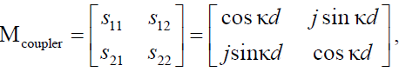
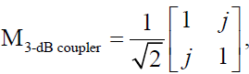
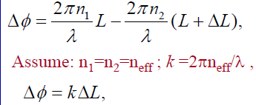
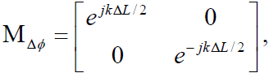
Details for matrix of each component :
3-dB splitting coupler : Mcoupler
Coupler matrix :
3-dB coupler matrix (no loss) :
Phase shift : MΔΦ
Assuming same sources for the two arms, phase shift due to the arm length
difference:
Matrix of the phase shift :

Slide 43
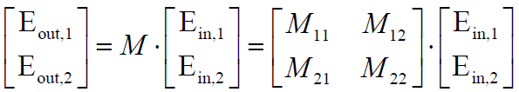
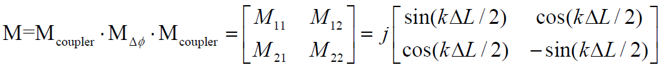
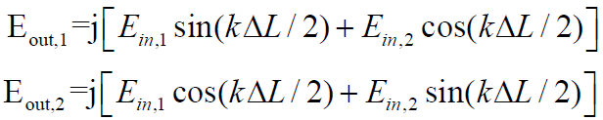
Total matrix : M
Find output E-field Eout,1 and Eout,2 :

Slide 44
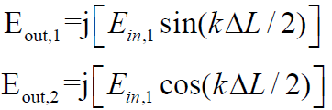
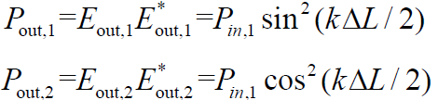

Assume that Ein,2 = 0,
Find output power (or intensity) Pout,1 and Pout,2 :
Spectrum or magnitude response of Pout,1 and Pout,2:

Slide 45


Maximum and minimum of Pout,1 and Pout,2:
When:
kΔL / 2 = mπ
Pout,1= 0; Pout,2= 1
kΔL / 2 = mπ
Frequency spacing for bar or cross:
This gives rise to the frequency spacing for the two Mux/Demux frequency is Δf / 2, i.e.,

Slide 46
Example of a four-channel multiplexer using three 2x2 MZI elements

Slide 47


Assume that the input wavelengths of 2x2 silicon MZI are separated by 10 GHz (i.e., Δλ =0.08 nm at 1550 nm). With neff =1.5 in a silicon waveguide, find the waveguide length difference ΔL.

Slide 48

Dielectric thin film filters
A dielectric thin film filter (TFF) is used as an optical band pass filter. It allows a very narrow wavelength band to pass through it and reflects all others.
The basis of these devices is Fabry-Perot filter structure, which is a cavity formed by two parallel highly reflective mirror surface as shown in Fig. below. The other names of this structure are Fabry-Perot Interferometer, etalon and thin film resonant cavity filter.

Slide 49
Consider a light signal that is incident on the left surface of the etalon. After light passes through the cavity and hits the surface on the right, some of the light leaves the cavity and some is reflected.
The amount of light that is reflected depends on the reflectivity R of the surface.
If the roundtrip distance between the two mirrors is an integral multiple of a wavelength then all light at those wavelength which pass through the right facet add in phase (constructive interference).
These wavelength are called the resonator wavelengths of the cavity. The etalon rejects all other wavelengths.

Slide 50

The transmission T (power transfer function) of an ideal etalon in which there is no absorption by the mirrors is an Airy function given by
Where R is the reflectivity of the mirrors and
$$φ=\frac{2π}{λ}2nDcosθ$$
is the roundtrip phase change of the light beam
N is the refractive index of the dielectric layer that forms the mirror,
D is the distance between the mirrors
$$θ$$
is the angle to the normal of the incoming light beam.

Slide 51
Fig gives the generalized plot for an airy function over the range -3π ≤Φ≤3π
Fig. The behavior of resonant wavelength in Fabry-Perot cavity for three values of mirror reflectivity based on Airy function

Slide 52


Fig shows that the power transfer function is periodic in f.
The peaks of the spacing called the passbands occur at those wavelengths that satisfy the condition N =2nD, where N is an integer.
The distance between the adjacent peaks is called the free spectral range or FSR given by
The finesse F of the filter gives an approximation of the number of wavelength that a filter can accommodate and given by the ratio of full spectrum range to the full width half maximum i.e.

Slide 53
To create a wavelength multiplexing device for combining or separating N wavelength channels, one needs to cascade N-1 thin film filters.

Slide 54
➢ Fig. illustrates a multiplexing function for the four wavelengths λ₁,λ₂,λ₃,λ₄. Here the filters labeled
TFF₂,TFF₃ and TFF₄ pass wavelengths λ₂,λ₃ and λ₄ respectively and reflect all others.
➢ First filter TFF2 reflects λ₁ and allows λ₂ to pass through. These two signals then are reflected from
TFF₃where they are joined by λ₃. After similar process at TFF₄ the four wavelengths can be coupled
into a fiber by means of lens mechanism.
➢ To separate the four wavelengths from one fiber into four independent channels the direction of the
arrows in Fig. are reversed.

Slide 55
Active Optical Components:
Active optical components require some type of external energy either to perform their functions or to be used over a wide operating range, thereby offering greater application flexibility.
These device include variable optical attenuators, tunable optical filters, dynamic gain equalizers, optical add/drop multiplexers, polarization controllers and dispersion compensators.
Many of the active optical components are based on using micro-electical-mechanical systems of MEMS technology.

Slide 56
MEMS Technology:
MEMS is the acronym for micro electro mechanical systems. These are miniature devices that can combine mechanical, electrical and optical components to provide sensing and actuation functions by means of micro gears or movable levers, shutters or mirrors.
These devices are widely used in automobile air-bag deployment systems, in ink-jet printer heads, for monitoring mechanical shock etc.
Fig. A simple example of MEMS actuation method

Slide 57
Fig. shows a simple example of MEMS actuation method. At the top of the device there is thin suspended polysilicon beam that has typical length, width and thickness of 80μm, 10μm and 0.5μm.
At the bottom there is silicon ground plane which is covered by an insulator material. There is a gap of nominally 0.6μm between the beam and the insulator.
When a voltage is applied between the silicon ground plane and the polysilicon beam, the electric force pulls the beam down so that it makes contact with the lower structure.
Initially MEMS devices were based on silicon technology which is very stiff material that require higher voltages to achieve a given mechanical deflection.
To reduce these required forces, current MEMS devices are being made with soft rubber like material called elastomer. This is referred to as compliant MEMS or CMEMS.

Slide 58
Variable optical attenuators:
A variable optical attenuator (VOA) offers dynamic signal level control. This device attenuates optical power by various means to control signal levels precisely without disturbing other properties of a light signal.
They are polarization independent and have a dynamic range of 15 to 30dB.
The control methods include mechanical, thermo-optic, MEMS or electro optic techniques.
The mechanical control methods are reliable but have a low dynamic range and slow response time.
Thermo-optic methods have high dynamic range, but are slow and require the use of thermoelectric cooler which may not be desirable.
The two most popular control methods are MEMS based and electro-optic based techniques.
For MEMS techniques an electrostatic actuation method is used where a voltage change across a pair of electrodes provides an electrostatic actuation force. This requires lower power levels than other methods and is the fastest.

Slide 59
Tunable optical filters:
The two key technologies to make a tunable filter are MEMS based and Bragg grating based devices.
MEMS based tunable filters have the advantage of wide tuning range and design flexibility.
o The MEMS based device consists of two sets of epitaxially grown semiconductor layers that form a single Fabry-Perot cavity.
o The device operation is based on allowing one of the two mirrors to be moved precisely by an actuator. This enables a change in the distance between the two cavity mirrors, thereby resulting in the selection of different wavelengths to be filtered.

Slide 61
Fiber Bragg gratings are wavelength selective reflective filters with steep spectral profiles as shown in Fig.
These filters involve a stretching and relaxation process of the spacing in the fiber grating.
Since glass is a slightly stretchable medium, as an optical fiber is stretched with the grating inside of it, the spacing of the index perturbation and refractive index will change.
This process induces a change in the Bragg wavelength thereby changing the center wavelength of the filter.
Such optical fibers can be made for the S,C and L bands and for operation in the 1310nm region.
The stretching can be done by thermo-mechanical, piezoelectric and stepper motor means as shown in Fig.

Slide 62
Fig. three methods for adjusting the wavelength of a tunable Bragg grating

Slide 63
The thermo-mechanical method use a bimetal differential expansion element which changes its shape as its temperature varies. This method is expensive but it is slow, takes time to stabilize and has limited tuning range.
The piezoelectric techniques use a material that changes its length when a voltage is applied. Although this method provides precise wavelength resolution, it is more expensive, complex to implement and has limited tuning range.
The stepper motor method changes the length of the fiber grating by pulling or relaxing one end of the structure. It has a moderate cost, is reliable, and has reasonable tuning speed.

